Slide 1
Data Architecture
data types, databases

Slide 2
Data types
event data, entity data

Slide 3

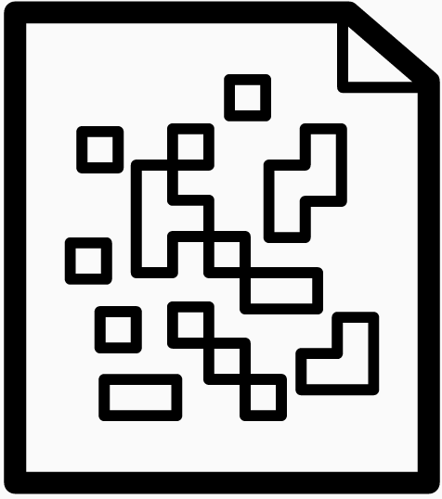



Structured
Semi-structured
Unstructured
Event data
Entity data
External data

Slide 4
Entity data
Cust. ID | Name | Surname | Address | e-mail | Phone
123 | Andrzej | Kowalski | ul. Polna 12, Warszawa | andrzej.kowalski@adres.pl | 12-345-678
234 | Anna | Tobiasz | ul. Kowalska 11, Kielce | anna.tobiasz@adres.pl | 12-345-679
345 | Krzysztof | Tomaszewski | ul. Tokarska 15, Lublin | krzysztof.tomaszewski@adres.pl | 12-345-778
Represent the current state of an object - user, product, price, etc.
Entity: is a unique object, such as a customer, product, order, etc.
Attributes of an entity: are the properties that describe it.
Examples of entities: Customer, Product, Order
Product ID | Color | Weight [kg] | Price [PLN] | SKU No. | Country of origin
C_01 | Red | 1 | 100 | 12345 | Polska
Z_01 | Green | 2 | 200 | 23456 | Niemcy
N_02 | Blue | 3 | 300 | 34567 | Chiny
Order No. | Date | Product ID | Customer ID | No. of items | Value [PLN]
Z_001 | 15.06.2022 | C_01 | 123 | 2 | 200
Z_002 | 16.06.2022 | Z_01 | 123 | 3 | 600
Z_003 | 17.06.2022 | N_02 | 234 | 4 | 1200

Slide 5
Event data
Represent the actions performed by objects
Example:
Action: the customer opened a promotional email.
Timestamp: is the time when it happened - October 6 at 6:15pm.
State: will refer to all other relevant data, such as mobile device, tablet or computer, and browser.
A special case: server logs
Modern systems generate far more event data than entity data. There can be thousands of events for every user using an application.
Event ID | Event type | Time-stamp | OS | Browser
asjhdg4wrasdjhg3jhgad-123123-kjahsd-091283091823 | email_open | 10/06/2022 17:22:00 | MS Windows | Chrome
aajkshdfhg3jhgad-123123-kjahsd-091283091823 | Link_click | 10/06/2022 17:23:00 | MacOS | Safari
lajksdhflaksjdf763123123-kjahsd-091283091823 | email_open | 10/06/2022 17:25:00 | Linux | Chrome

Slide 6
Event data can be aggregated for business analysis (e.g. KPIs)
Event ID | Marketing event | Date | Time | Place-ad
asjhdg4wrasdjhg3jhgad-123123-kjahsd-091283091823 | ad_click | 10/06/2022 | 17:22:00 | side_bar
aajkshdfhg3jhgad-123123-kjahsd-091283091823 | ad_click | 10/06/2022 | 17:23:00 | footer
lajksdhflaksjdf763123123-kjahsd-091283091823 | ad_close | 10/06/2022 | 17:25:00 | footer
Number of active users
Daily active users (DAU)
Weekly active users (WAU)
Monthly active users (MAU)
Session length
Time spent by a user using your application during one session.
Click-through rate (CTR)
The ratio of the number of users who clicked on an ad or banner to the number of users who viewed the page with that ad or banner.
Rejection Rate (BR)
The percentage of users who leave the site after viewing only one page.
Conversion Rate (CR)
The percentage of users who perform the desired action.
 | side_bar | footer
ad_click | 215 | 112
ad_close | 310 | 220
total_displays | 525 | 332
Click-Through Ratio (CTR) | 40% | 34%

Slide 7
Entity data vs event data
Entity data | Event data
Describe objects | Describe objects actions
Describe present state | Describe trends in time
Are updated | Are appended

Slide 8
Data categories
structured, semi-structured, unstructured

Slide 9
Structured data
Can be organized in tables
Relationships can be specified
Can be queried using Structured Query Language (SQL)
Requires a schema to be specified: how the data is organized
ID | Name | Age | Education
1 | Anna | 21 | bachelor
2 | Andrzej | 25 | master
3 | Krzysztof | 30 | master
4 | Monika | 30 | PhD
5 | Helena | 35 | master

Slide 10
Semi-structured data
They are not compatible with relational databases such as Excel or SQL, but they do have some level of organization, such as tags.
Are not strictly relational
Once processed, they can be stored in:
- relational databases
- NoSQL databases
- CSV, XML and JSON files
<University>
<StudentID = `1`>
<Name>Anna </Name>
<Age>21</Age>
<Education>Bachelor</Education>
</Student>
<StudentID = `2`>
<Name>Andrzej </Name>
<Age>25</Age>
<Education>Master</Education>
</Student>
…
</University>

Slide 11
Unstructured data
Mostly qualitative data
No schema/model
No relationships
Can be stored in NoSQL databases and data lakes
Examples: audio files, video files, text documents, posts on discussion forums, etc.
Our university has 2200 students.
Ann has the index number 1, she is 21 one year old and already has a bachelor's degree.
Andrew has number 2, he is a bit older (25 years old) and has a Master's degree.
Another student is Christopher, who...

Slide 12
Databases
SQL

Slide 13
Structured data
Customer | Imię | Nazwisko
CustomerID | Name | Surname
123 | Andrzej | Kowalski
234 | Anna | Tobiasz
345 | Krzysztof | Tomaszewski
Organized in tables
One can specify relationships between them
Can be queried using Structured Query Language (SQL)
Requires a schema to be specified: a way of organizing data
Key technology: OLTP (OnLine Transaction Processing)
Examples of SQL databases: Oracle, MS SQL Server, MySQL, PostgreSQL
Typical applications: financial systems, ...
Order | Nazwa | Waga [kg]
ProductID | Quantity | CustomerID
C_01 | 5 | 123
Z_01 | 12 | 234
N_02 | 21 | 345
Product | Nazwa | Waga [kg]
ProductID | Name | Country of origin
C_01 | Notepad | Poland
Z_01 | Ballpen | Germany
N_02 | Pencil | China

Slide 14
Databases
No SQL

Slide 15
No SQL: document oriented
Customer
{ „ID”: 1 „Name”: Ania „Surname”: Kowalska }
No fixed schema
Data stored in JSON (JavaScript Object Notation) documents
Each document can have a different set of fields
Example databases: MongoDB, CouchDB, DocumentDB
Example applications: Document management systems
Customer
{ „ID”: 2 „Name”: Andrzej „Surname”: Tokarski }

Slide 16
No SQL: column databases
Customer
Data stored in columns (not rows)
Effect: operations (queries, additions, deletions, etc.) based on columns run very fast in them
Examples of databases: Cassandra
Example applications: advanced data analysis
CustomerID
123
234
345
Name
Anna
Tomasz
Jan
Surname
Kowalska
Nowakowski
Poniatowski

Slide 17
No SQL: key-value based
Each entry has a unique key
Effect: enable faster data writing and reading
Example databases: Redis, Amazon Dynamo DB
Example applications: customer reviews
{
„Product name”: „Notepad”
„Country of origin”: „Poland”
}
123
234
{
„Product name”: „Ballpen”
„Country of origin”: „Germany”
}

Slide 18
No SQL: graph databases
Customer
Data stored in the form of graphs
Focusing on connections (relationships) between points (objects)
Used in relationship analyses
Example databases: Neo4j, Inifinite Graph
Example applications: social network analysis
Name: Andrzej
follows
follows
Customer
Name:
Tomasz
Name:
Anna
Customer
follows
follows

Slide 19
Data warehouses

Slide 20
OnLine Transaction Processing (OLTP) systems
Systems underlying transaction-based systems
customer buys the product
customer removes product from cart
customer changes the quantity of the ordered goods

Slide 21
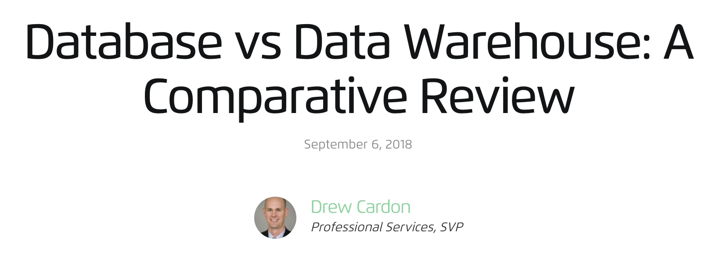
Why?
Databases based on OLTP (OnLine Transaction Processing) technology are designed to ensure efficient operation of transactional systems.
The are not optimized for analytics
Data warehouses are based on OLAP (Online Analytical Processing) technologies. They use data collected in databases (OLTP) and create a layer optimized for analytical applications

Slide 22


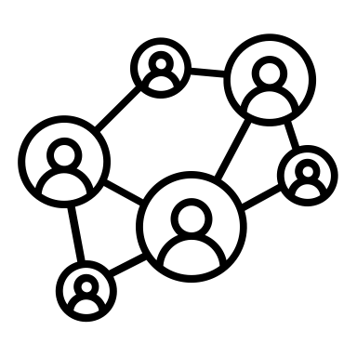
OnLine Analytical Processing (OLAP)
Systems to assist users in interactive analysis of multidimensional data:
- Grouping
- Drill-down
- Pivot tables
Integrate data from different sources
data consumers
OLTP
transaction database
data analytics
OLAP data warehouse
OLAP server
external data sources
data mining

Slide 23

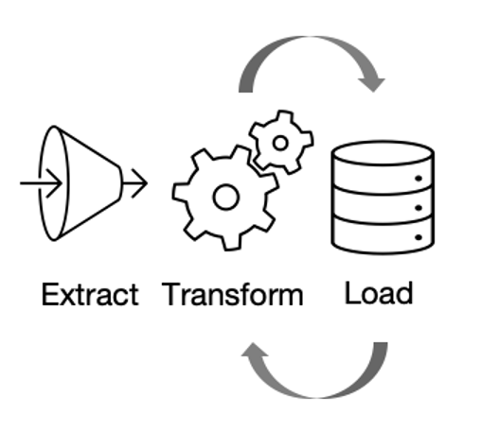
Data warehouse
A central repository of information optimized for business analytics
Data sources include various transaction systems and other databases
ERP
data consumers
BI
data analytics
OLAP data warehouse
sales
logistics
data mining

Slide 24
Data warehouse: advantages
Consolidation of data in one place
Faster analyses
Easier and faster data transformation, data enrichment and feature engineering processes
Improved data quality
ERP
data consumers
BI
data analytics
OLAP data warehouse
sales
logistics
data mining

Slide 25
Data warehouse: disadvantages, limitations
Can be expensive
Require ongoing maintenance (cleanup, transformation, data integration, ...)
Too complex for ad hoc analytical needs
ERP
data consumers
BI
data analytics
OLAP data warehouse
sales
logistics
data mining

Slide 26
Data warehousing: when to use?
Data mining:
- multiple distributed databases/domain systems
- large databases
- large amounts of historical data
Example applications:
- marketing data analysis: large amount, multiple dimensions
- user behavior analysis: large number, many different sources
ERP
data consumers
BI
data analytics
OLAP data warehouse
sales
logistics
data mining

Slide 27
Data lakes

Slide 28
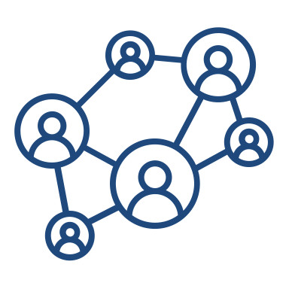


Data lake
A repository that stores data in its raw form
Typically a single collection of all enterprise data
Used for reporting, visualization, advanced analytics and machine learning
Contains structured, semi-structured and unstructured data
data filtering/ETL
social interactions
data processing
machine learning
data lake
multimedia communication
data warehouses
data visualization
customer data

Slide 29
Data lake: advantages
Can store large amounts of data
Data can be
- Structured
- Semi-structured
- Unstructured
No pre-load processing required
data filtering/ETL
social interactions
data processing
machine learning
data lake
multimedia communication
data warehouses
data visualization
customer data

Slide 30
Data lake: disadvantages, limitations
Technology that is still evolving
Problems with specialists
Data management can be cumbersome
Low costs can stimulate collection of unnecessary data
Data privacy: entire organization's data in one repository
data filtering/ETL
social interactions
data processing
machine learning
data lake
multimedia communication
data warehouses
data visualization
customer data

Slide 31
Data lake: when to use?
Cyber Security: collecting logs from multiple devices for security analysis
Customer Data: collecting and analyzing customer behavior data from multiple sources and channels (web, mobile, traditional stores, e-commerce, loyalty systems, CRM, etc.)
data filtering/ETL
social interactions
data processing
machine learning
data lake
multimedia communication
data warehouses
data visualization
customer data

